Slide 1
On The Spot
Submitted By: Team 20
Dishant Kimtani
Arshdeep Singh
Suhel Mehta
Shikhar Gaur

Slide 2
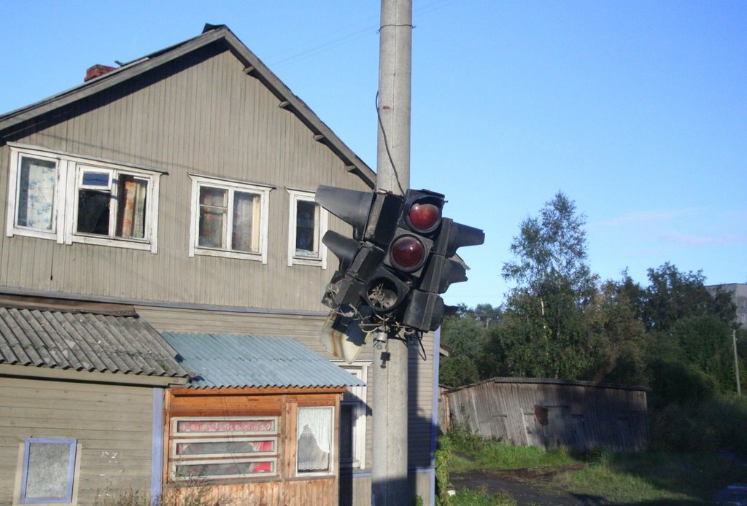
How to report a complaint??

Slide 3
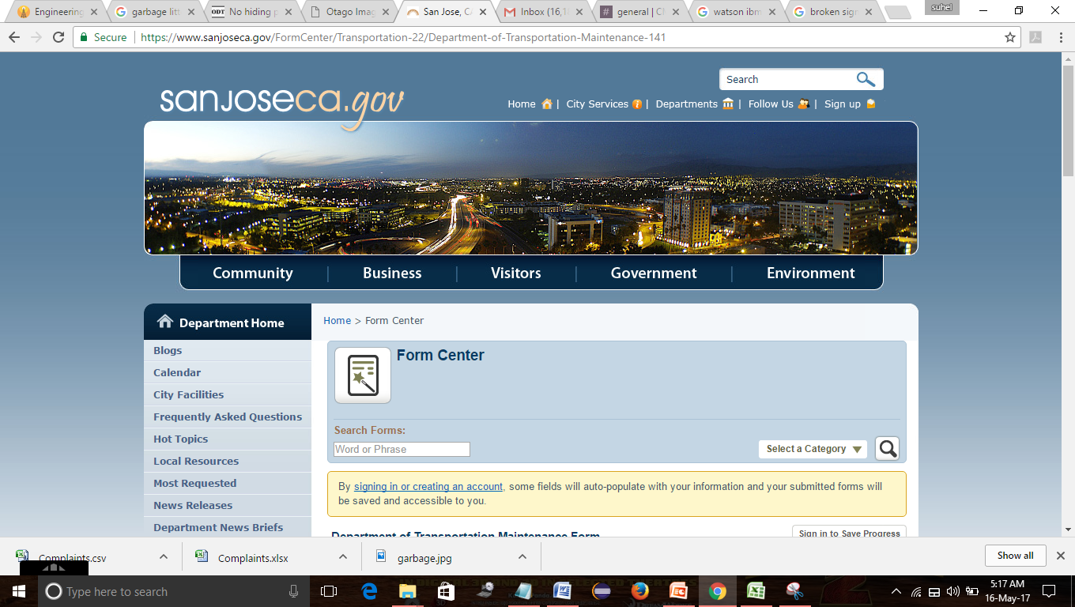
Visit “sanjoseca.gov”?

Slide 4

Or use “On the spot”!!
DEMO

Slide 5


